Slide 1

Learn Mate: A Web-based Educational Institute Management System
Presented by Group ID – 55 (2025-Y2-S1-MLB-B3G2-05)
Student ID
Student Name
IT24100300
Dulakshika A.L.S.H
IT24100263
Dilhani W. P. K. A
IT24100239
Disanayaka D.M.C.N
IT24100283
Devinda S. U. V
IT24100314
Dahanayake L.K
IT24100237
Bandara R. M. G. L

Slide 2

What We'll Discuss
1
Introduction: Addressing Educational Challenges
Understanding the current landscape and problems in educational management.
2
System Overview: Learn Mate Architecture
A high-level look at how Learn Mate is structured and functions.
3
Functional Requirements: Core System Capabilities
Key features and operations that Learn Mate will perform.
4
Non-Functional Requirements: Quality Attributes
How Learn Mate will perform in terms of reliability, security, and usability.
5
Major Stakeholders: Who Benefits?
Identifying the primary users and beneficiaries of the system.
6
Six Major Functions: Team Responsibilities
Detailed breakdown of the system's main functionalities and development roles.
7
Minor Functions: Enhancing User Experience
Additional features that improve overall user interaction and efficiency.
8
System Limitations & Constraints
Acknowledging the boundaries and restrictions of the Learn Mate system.
9
Conclusion: Value & Future Outlook
Summarizing Learn Mate's impact and its potential for future development.

Slide 3



Introduction: Addressing Educational Challenges
Our educational institute faces challenges with scattered information, manual tasks, and lack of a centralized platform for students, teachers, and staff. This leads to delays, errors, and poor communication.
Scattered Information
Manual Tasks
Communication Gaps
Difficulty getting a clear overview of performance and progress.
Time-consuming routines like registration and timetable updates.
No central place for updates on schedules, grades, or payments.

Slide 4

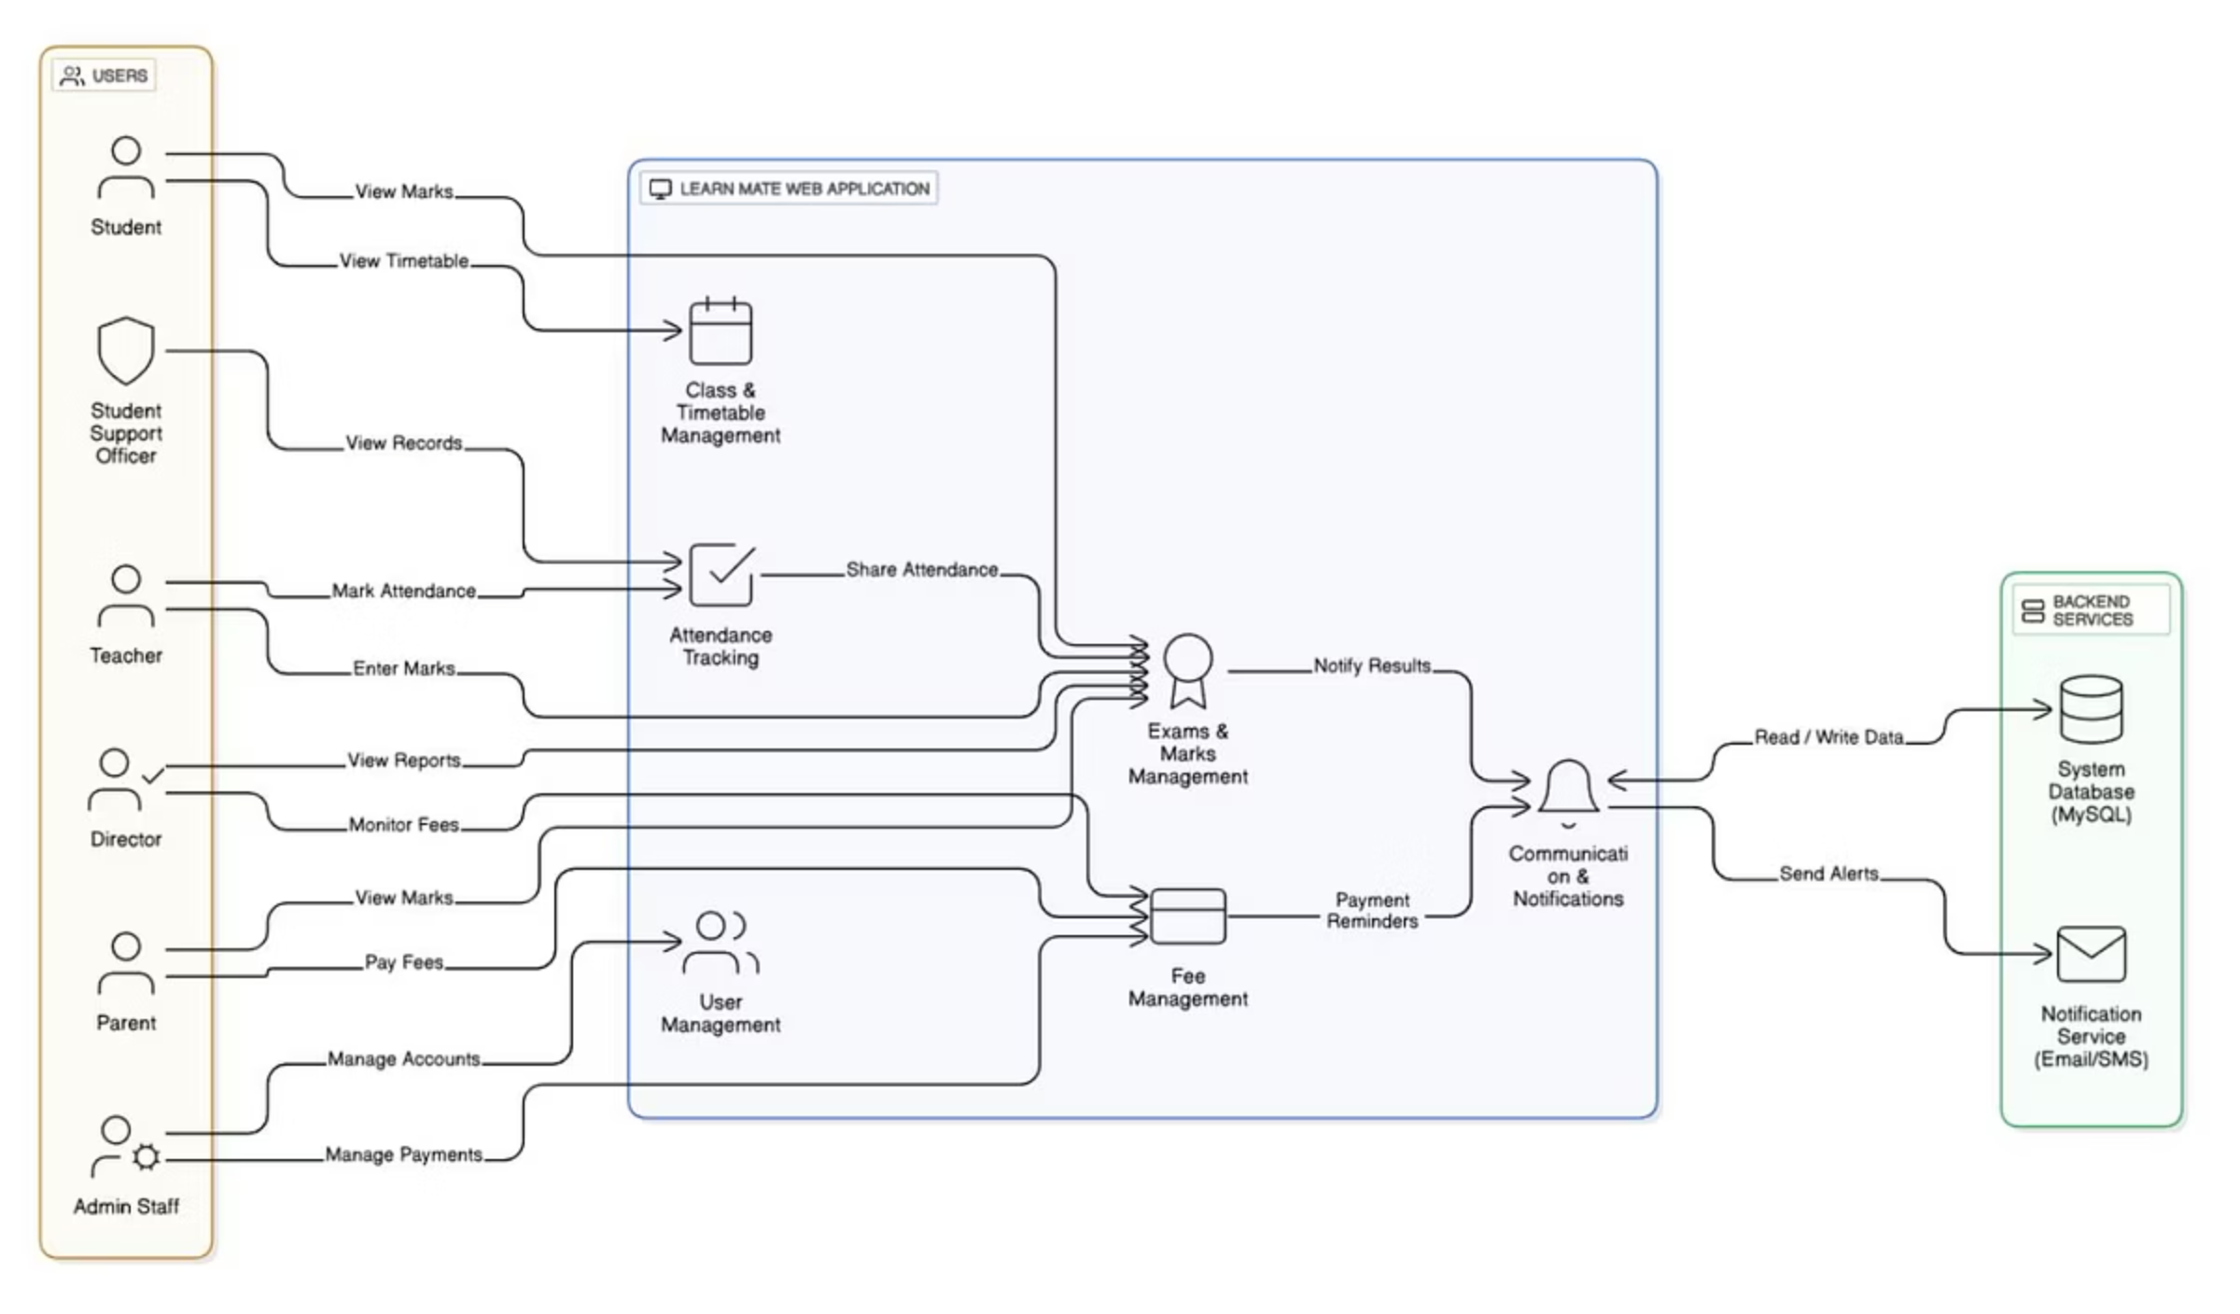
System Overview: Learn Mate Architecture
"Learn Mate" is an integrated web application designed to centralize administrative and academic tasks, improving efficiency and communication.
The diagram illustrates how primary user roles interact with core modules, connecting to a MySQL database and external notification services.

Slide 5
Functional Requirements: Core System Capabilities
User & Access Management
Timetable Management
Role-based permissions for secure login and feature access.
Create, update, and publish class schedules; personalized views.
Attendance Tracking
Exam & Marks Management
Teachers mark attendance; accessible by students, parents, staff.
Teachers enter grades; students/parents view results securely.
Fee Processing
Communication & Announcements
Admin manages records; parents view balances and pay online.
Tools for messages and announcements to specific user groups.

Slide 6
Non-Functional Requirements: Quality Attributes
These attributes ensure a positive user experience and a robust system.
1
2
3
Performance
Usability
Security
Key pages load under 3 seconds; data submission is instant.
Clean, simple interface; easy navigation without extensive training.
Secure authentication, encrypted passwords, strict role-based access.
4
5
Compatibility
Cross-platform
Functions on modern web browsers (Chrome, Firefox, Edge).
Smooth operation on desktops, tablets, and smartphones.

Slide 7





Major Stakeholders: Who Benefits?
The "Learn Mate" system serves diverse users, each with unique needs.
Director
Admin Staff
Monitors overall performance via summary reports.
Manages operations: registrations, timetables, fees, announcements.
Teachers
Students
Academic management: attendance, grades, materials, communication.
Checks timetables, views grades/attendance, receives updates.
Parents
Student Support Officer
Monitors child's progress, tracks attendance, pays fees online.
Identifies at-risk students for timely intervention.

Slide 8
Six Major Functions: Team Responsibilities
User Management
Class & Timetable Management
Dulakshika A.L.S.H: Creates and manages all user accounts, assigns roles, ensures secure logins.
Bandara R. M. G. L: Automates scheduling, provides interface for admin to create/publish timetables.
Attendance Tracking
Exams & Marks Management
Dilhani W. P. K. A: Digitizes attendance recording for teachers, centralizes data for viewing.
Dahanayake L.K: Centralizes assessment, allows teachers to enter marks, students/parents view results.
Fee Management
Communication & Notifications
Devinda S. U. V: Simplifies fee collection, tracks payments, sends reminders, provides online payment portal.
Disanayaka D.M.C.N: Central hub for announcements, messages, and automated alerts to users.

Slide 9
Minor Functions: Enhancing User Experience
User Profile Management
Users can view and update personal information, ensuring data accuracy.
Password Reset
Self-service option via registered email, reducing admin burden.
Search and Filter Options
Basic search functionality for quick information retrieval (e.g., student records, announcements).
Downloadable Reports/Documents
Users can download fee receipts or mark sheets in PDF format.
Notification History
Dedicated section to view past notifications and announcements.

Slide 10

System Limitations & Constraints
Technical Constraints
Project Constraints
Technology Stack: Java-based web application with MySQL database.
Development Timeline: Strictly time-bound to 14-week semester.
External Dependencies: Notification system relies on third-party APIs.
Defined Scope: Limited to six major functions; no advanced features like mobile app or e-learning.
No Offline Functionality: Requires constant internet connection.
Single Institute Focus: Not designed as a multi-tenant application.

Slide 11
Conclusion: Value & Future Outlook
"Learn Mate" addresses operational and communication challenges by centralizing processes, automating tasks, and providing immediate access to information.
Efficiency
Transparency
Connection
Automates administrative tasks, saving time and reducing errors.
Empowers students and parents with immediate access to information.
Provides teachers with powerful academic management tools.
Our team has a clear understanding of requirements and a realistic 14-week development plan, ensuring substantial value and a strong foundation for future digital initiatives.

Slide 12
Thank You
We appreciate your time and interest in Learn Mate.

